Slide 1
Grade- IX
Lesson-2
PEOPLE AS RESOURCE

Slide 2
Conduct a survey about any occupation and undergo a case study of any known personality connected to that occupation. Record the survey and prepare a report.
Notes:
R

Slide 3
CONTENT SLIDE

Slide 4
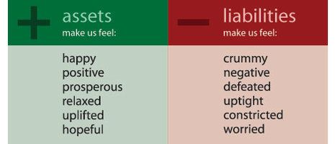
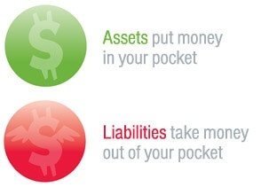

Slide 8
Questions based on the above slides:
What can you infer from the story of Sakal and Vilas?
Mentions the areas which come under primary sector.

Slide 9
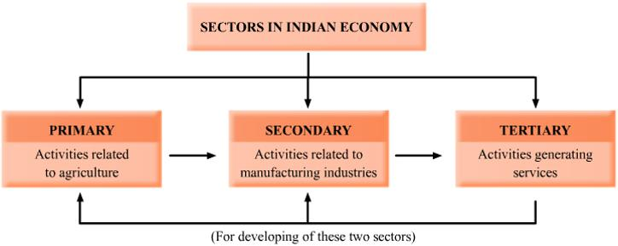

Slide 10
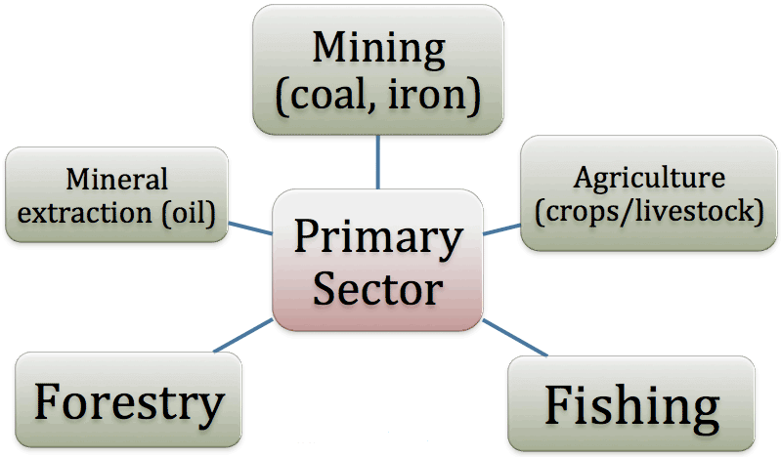
CONTENT SLIDE

Slide 11
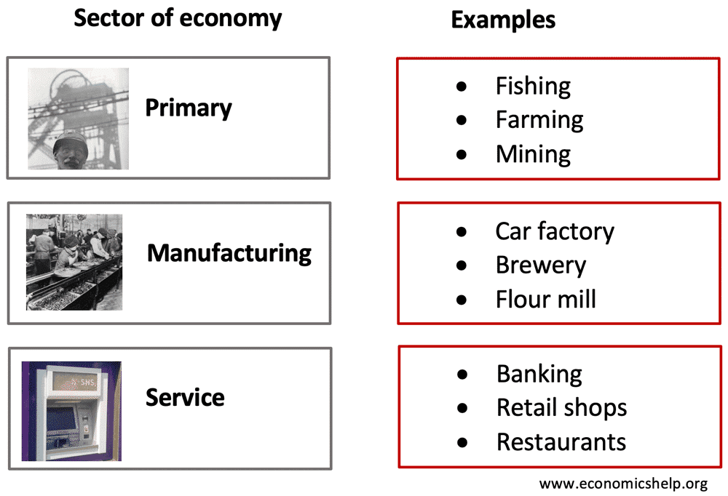

Slide 12
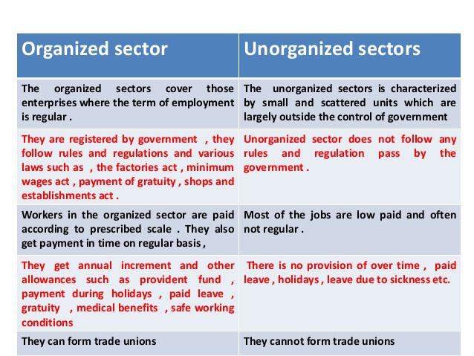

Slide 13
7/28/20

Slide 14
7/28/20

Slide 15
7/28/20

Slide 16
7/28/20

Slide 17
7/28/20

Slide 18
7/28/20

Slide 19
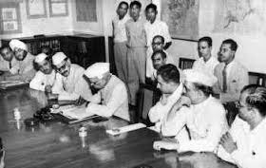

Slide 21
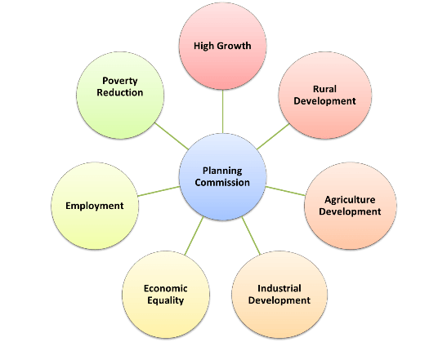

Slide 22
Questions related to the above slides:
Differentiate between unemployment and underemployment.
2) Define infant mortality.
3) Mention any four features of Navodaya Vidyalayas.

Slide 23
References
https://www.youtube.com/watch?v=-D7ry58cL4s&t=32s

